Slide 1
Sequence to Sequence
(Encoder-Decoder Framework)

Slide 2
Seq2Seq
Large vocabulary
Limitations

Slide 3
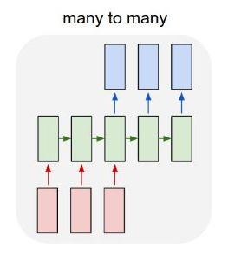
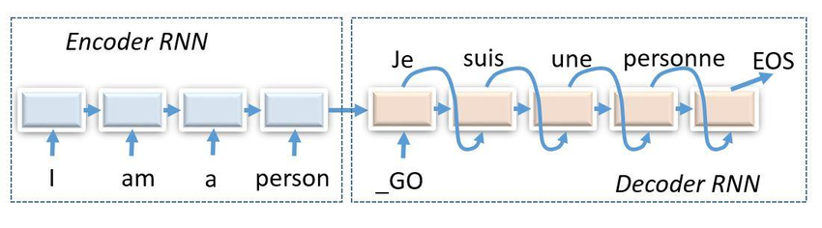
Seq2Seq
Large Vocabulary
Limitations
1. Sequence to Sequence (Seq2Seq) model
RNN 구조를 응용한 모델
Input sequence 로부터 target sequence 를 예측하는 모델

Slide 4
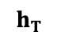
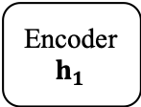
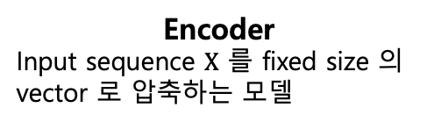
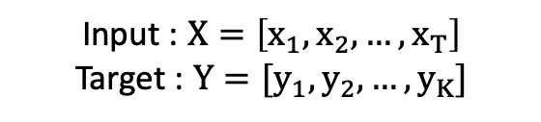
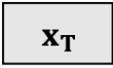
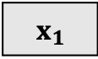
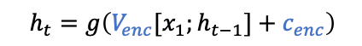
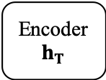
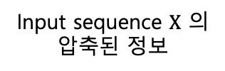
Seq2Seq
Large Vocabulary
Limitations
1. Sequence to Sequence (Seq2Seq) model
Training
Input : $X=\left[x_{1},x_{2},…,x_{T}\right]$
Target : $Y=[y_{1},y_{2},…,y_{K}]$
$$h_{t}=g\left(V_{enc}[x_{1};h_{t−1}]+c_{enc}\right)$$
Encoder
$$h_{1}$$
…
Encoder
$$h_{T}$$
$$h_{T}$$
$${ x}_{1}$$
…
$${ x}_{T}$$
Input sequence $X$ 의 압축된 정보
Encoder
Input sequence $X$ 를 fixed size 의 vector 로 압축하는 모델

Slide 5
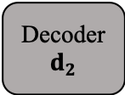

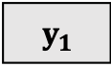
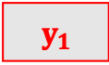
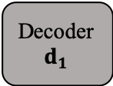
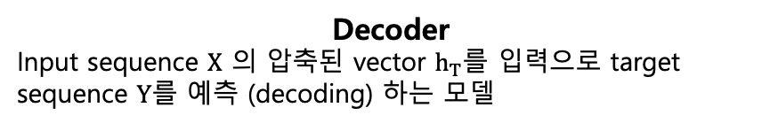
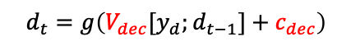
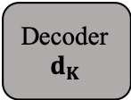
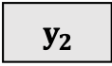
Seq2Seq
Large Vocabulary
Limitations
1. Sequence to Sequence (Seq2Seq) model
Training
Input : $X=\left[x_{1},x_{2},…,x_{T}\right]$
Target : $Y=[y_{1},y_{2},…,y_{K}]$
$${ y}_{1}$$
$${ y}_{2}$$
…
<EOS>
$$h_{t}=g\left(V_{enc}[x_{1};h_{t−1}]+c_{enc}\right)$$
$$d_{t}=g\left(V_{dec}[y_{d};d_{t−1}]+c_{dec}\right)$$
Encoder
$$h_{1}$$
…
Encoder
$$h_{T}$$
Decoder
$$d_{1}$$
Decoder
$$d_{2}$$
…
Decoder
$$d_{K}$$
$$h_{T}$$
$${ x}_{1}$$
…
$${ x}_{T}$$
<EOS>
$${ y}_{1}$$
…
$${ y}_{K}$$
Encoder
Input sequence $X$ 를 fixed size 의 vector 로 압축하는 모델
Decoder
Input sequence $X$ 의 압축된 vector $h_{T}$를 입력으로 target sequence $Y$를 예측 (decoding) 하는 모델

Slide 6
Seq2Seq
Large Vocabulary
Limitations
1. Sequence to Sequence (Seq2Seq) model
Test
Input : $X=\left[x_{1},x_{2},…,x_{T}\right]$
Target : $Y=[y_{1},y_{2},…,y_{K}]$
$$h_{t}=g\left(V_{enc}[x_{1};h_{t−1}]+c_{enc}\right)$$
Encoder
$$h_{1}$$
…
Encoder
$$h_{T}$$
$$h_{T}$$
$${ x}_{1}$$
…
$${ x}_{T}$$

Slide 7
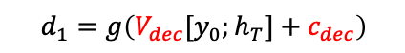
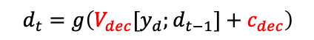
Seq2Seq
Large Vocabulary
Limitations
1. Sequence to Sequence (Seq2Seq) model
Test
Input : $X=\left[x_{1},x_{2},…,x_{T}\right]$
Target : $Y=[y_{1},y_{2},…,y_{K}]$
$$d_{t}=g\left(V_{dec}[y_{d};d_{t−1}]+c_{dec}\right)$$
$${ y}_{1}$$
$$d_{1}=g\left(V_{dec}[y_{0};h_{T}]+c_{dec}\right)$$
Encoder
$$h_{1}$$
…
Encoder
$$h_{T}$$
Decoder
$$d_{1}$$
$$h_{T}$$
$${ x}_{1}$$
…
$${ x}_{T}$$
<EOS>

Slide 8
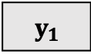
Seq2Seq
Large Vocabulary
Limitations
1. Sequence to Sequence (Seq2Seq) model
Test
Input : $X=\left[x_{1},x_{2},…,x_{T}\right]$
Target : $Y=[y_{1},y_{2},…,y_{K}]$
$$d_{t}=g\left(V_{dec}[y_{d};d_{t−1}]+c_{dec}\right)$$
$${ y}_{1}$$
$${ y}_{2}$$
$$h_{t}=g\left(V_{enc}[x_{1};h_{t−1}]+c_{enc}\right)$$
Encoder
$$h_{1}$$
…
Encoder
$$h_{T}$$
Decoder
$$d_{1}$$
Decoder
$$d_{2}$$
$$h_{T}$$
$${ x}_{1}$$
…
$${ x}_{T}$$
<EOS>
$${ y}_{1}$$

Slide 9
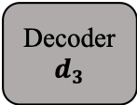
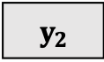

Seq2Seq
Large Vocabulary
Limitations
1. Sequence to Sequence (Seq2Seq) model
Test
Input : $X=\left[x_{1},x_{2},…,x_{T}\right]$
Target : $Y=[y_{1},y_{2},…,y_{K}]$
$$d_{t}=g\left(V_{dec}[y_{d};d_{t−1}]+c_{dec}\right)$$
$${ y}_{1}$$
$${ y}_{2}$$
$${ y}_{3}$$
$$h_{t}=g\left(V_{enc}[x_{1};h_{t−1}]+c_{enc}\right)$$
Encoder
$$h_{1}$$
…
Encoder
$$h_{T}$$
Decoder
$$d_{1}$$
Decoder
$$d_{2}$$
Decoder
$$d_{3}$$
$$h_{T}$$
$${ x}_{1}$$
…
$${ x}_{T}$$
<EOS>
$${ y}_{1}$$
$${ y}_{2}$$

Slide 10
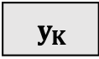
Seq2Seq
Large Vocabulary
Limitations
1. Sequence to Sequence (Seq2Seq) model
Test
Input : $X=\left[x_{1},x_{2},…,x_{T}\right]$
Target : $Y=[y_{1},y_{2},…,y_{K}]$
$$d_{t}=g\left(V_{dec}[y_{d};d_{t−1}]+c_{dec}\right)$$
$${ y}_{1}$$
$${ y}_{2}$$
…
<EOS>
$$h_{t}=g\left(V_{enc}[x_{1};h_{t−1}]+c_{enc}\right)$$
Encoder
$$h_{1}$$
…
Encoder
$$h_{T}$$
Decoder
$$d_{1}$$
Decoder
$$d_{2}$$
…
Decoder
$$d_{K}$$
$$h_{T}$$
$${ x}_{1}$$
…
$${ x}_{T}$$
<EOS>
$${ y}_{1}$$
…
$${ y}_{K}$$

Slide 11
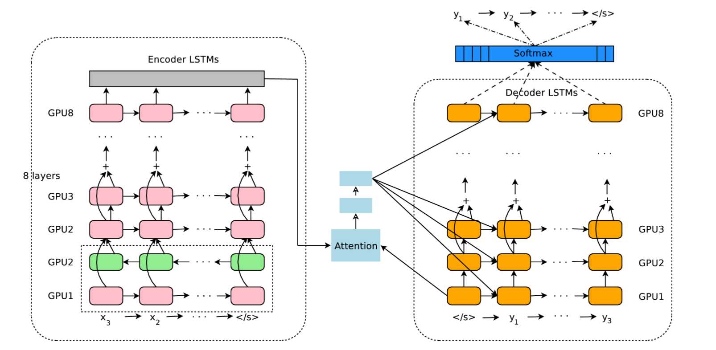
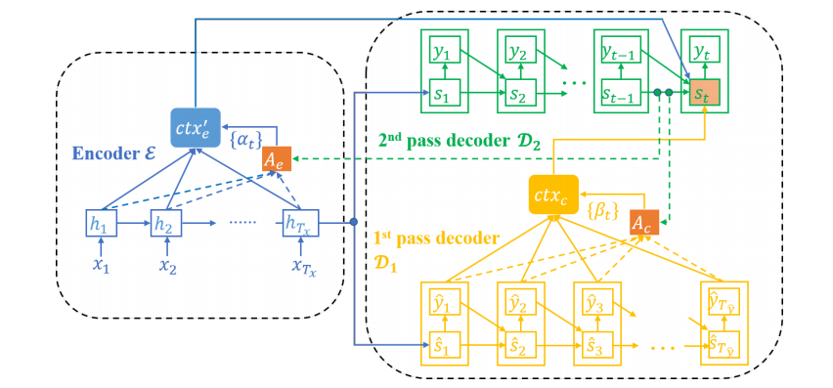
Seq2Seq
Large Vocabulary
Limitations
1. Sequence to Sequence (Seq2Seq) model
Usage : Machine Translation
Google’s Neural Machine Translation System: Bridging the Gap between Human and Machine Translation, Wu et al., (2016)

Slide 12
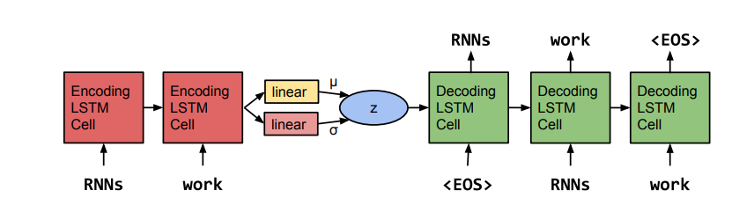
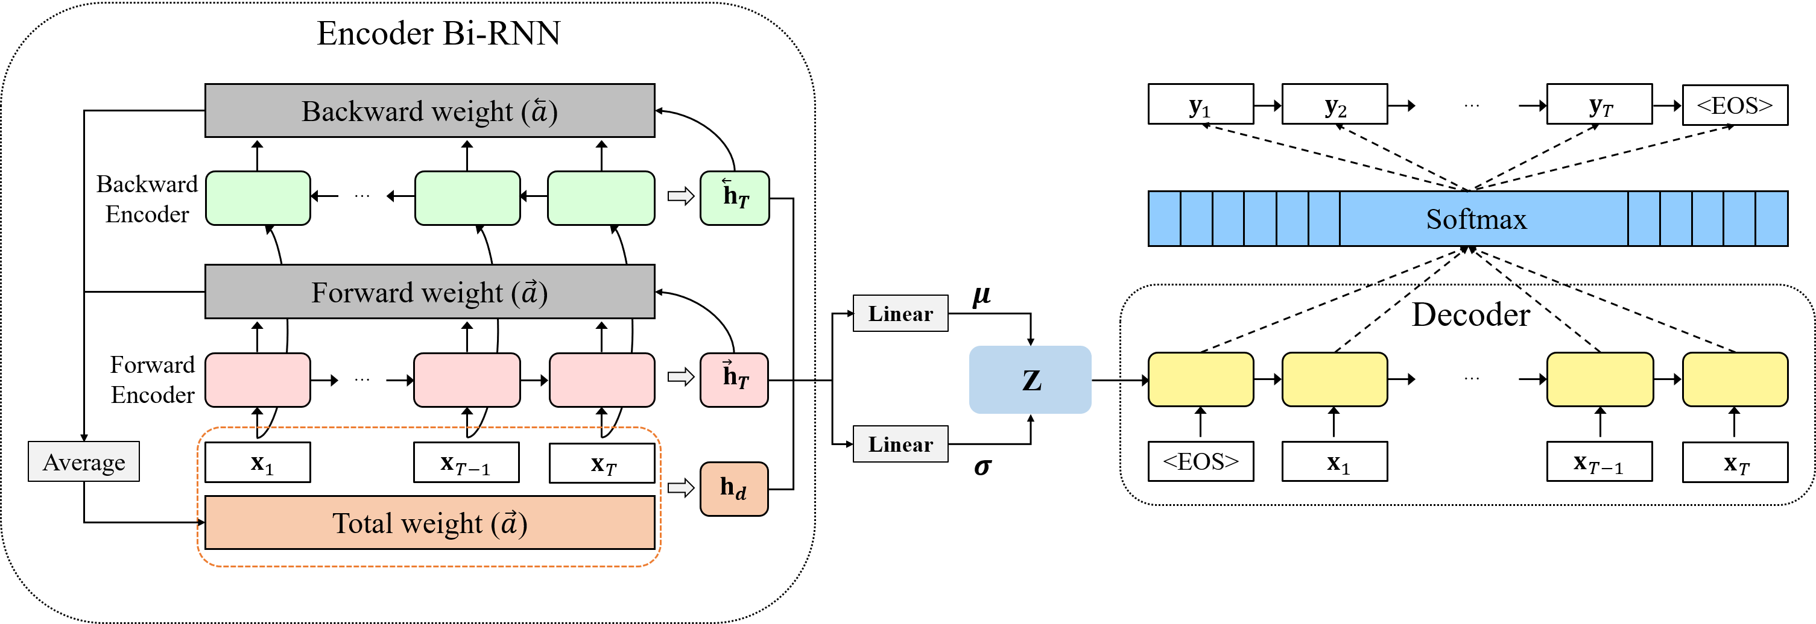
Seq2Seq
Large Vocabulary
Limitations
1. Sequence to Sequence (Seq2Seq) model
Usage : Auto encoder
Generating Sentences from a Continuous Space, Bowman et al., (2015)
Recurrent Neural Network-Based Semantic Variational Autoencoder for Sequence to Sequence Learning, Jang et al., (2019)

Slide 13
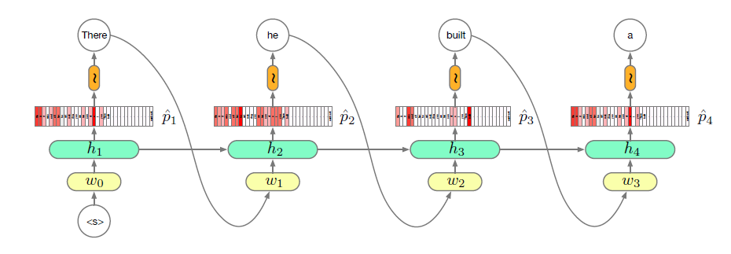
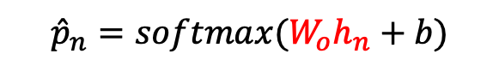

Seq2Seq
Large Vocabulary
Limitations
2. Large Vocabulary
- Much of the computational cost is dominated by calculating:
$${\hat{p}}_{n}=softmax(W_{o}h_{n}+b)$$
$$(\left|V\right|×h)×(h×1)$$
Solutions:
Short-list : use the RNN model for the most frequent words, and traditional N-gram model for the rest, easy to use but lose RNN’s main advantage (generalization to rare events)
Batch local short-lists

Slide 14
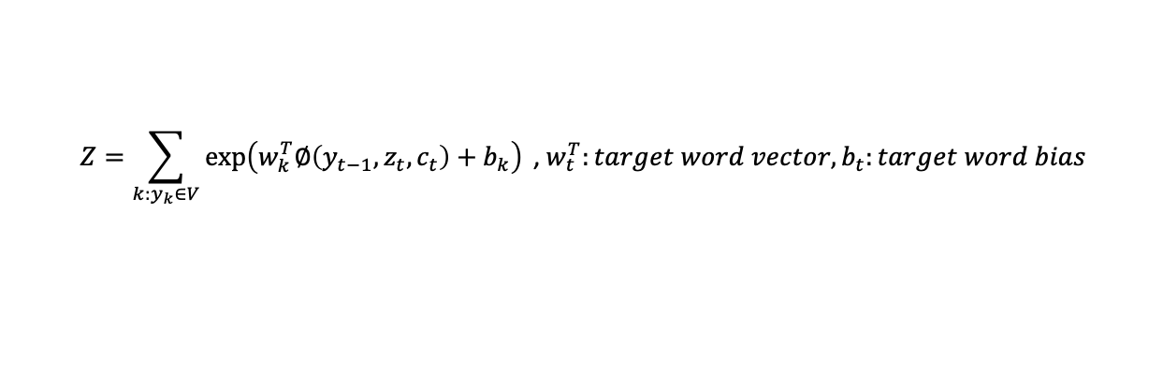
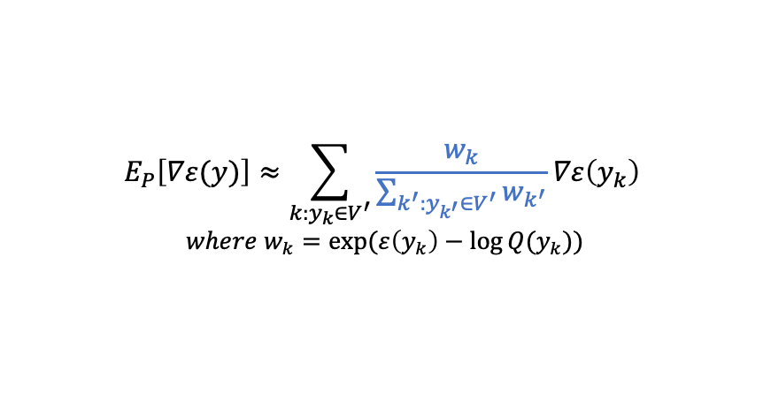
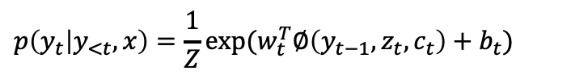
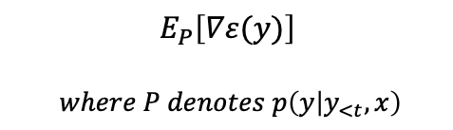
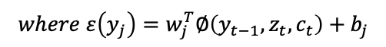
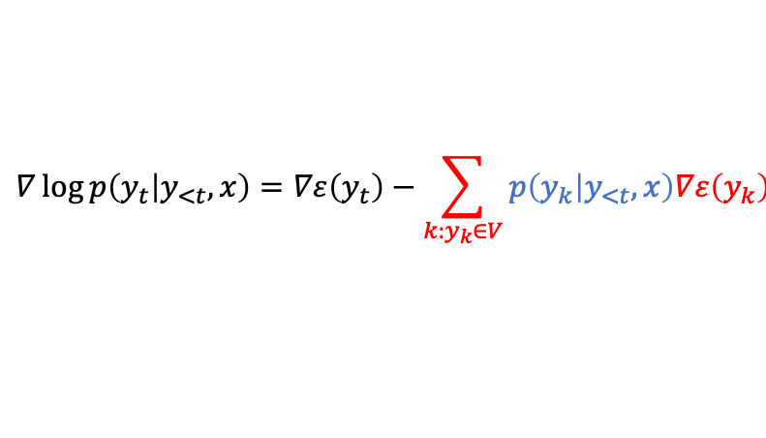
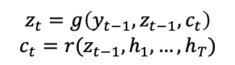
Seq2Seq
Large Vocabulary
Limitations
2. Large Vocabulary
Batch local short-lists
- Approximate full partition function from a subset of the vocabulary
Probability
$$p\left(y_{t} | y_{<t},x\right)=\frac{1}{Z}exp⁡(w_{t}^{T}∅\left(y_{t−1},z_{t},c_{t}\right)+b_{t})$$
$$z_{t}=g\left(y_{t−1},z_{t−1},c_{t}\right)$$
$$c_{t}=r(z_{t−1},h_{1},…,h_{T})$$
$$Z=\sum_{k:y_{k}∈V}{\exp\left(w_{k}^{T}∅\left(y_{t−1},z_{t},c_{t}\right)+b_{k}\right) \text{, }w_{t}^{T}:target word vector,b_{t}:target word bias}$$
Calculate gradient
$$∇\log{p\left(y_{t} | y_{<t},x\right)=∇ε\left(y_{t}\right)−\sum_{k:y_{k}∈V}{p\left(y_{k} | y_{<t},x\right)∇ε\left(y_{k}\right)}}$$
$$E_{P}\left[∇ε(y)\right]$$
$$where P denotes p\left(y | y_{<t},x\right)$$
$$where ε\left(y_{j}\right)=w_{j}^{T}∅\left(y_{t−1},z_{t},c_{t}\right)+b_{j}$$
Main idea
- Approximate expectation by sampling with a small number of samples
Given a predefined proposal distribution $Q$ and a set $V^{′}$ of samples from $Q$
$$E_{P}\left[∇ε(y)\right]≈\sum_{k:y_{k}∈V^{′}}{\frac{w_{k}}{\sum_{k^{′}:y_{k^{′}}∈V^{′}}{w_{k^{′}}}}∇ε\left(y_{k}\right)}$$
$$where w_{k}=exp⁡(ε\left(y_{k}\right)−\log{Q(y_{k})})$$
On Using Very Large Target Vocabulary for Neural Machine Translation, Jean at al., ACL 2015

Slide 15
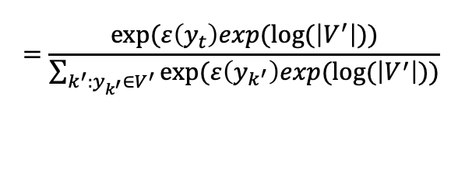
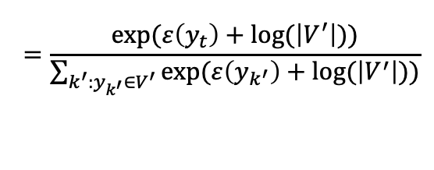
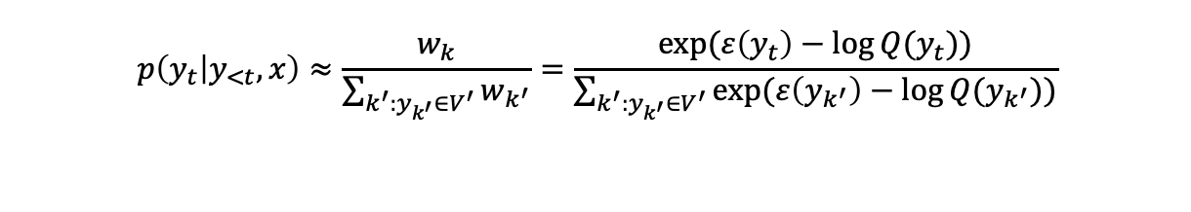
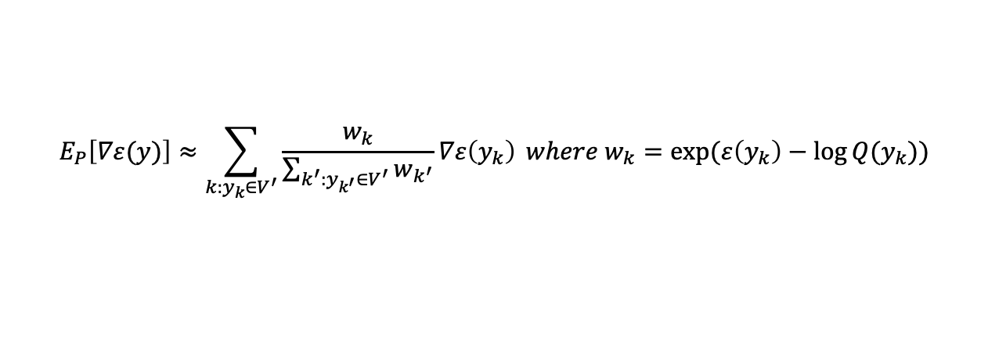
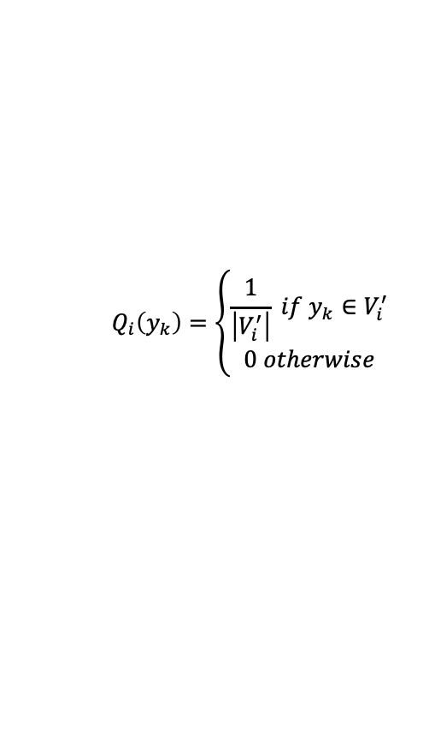
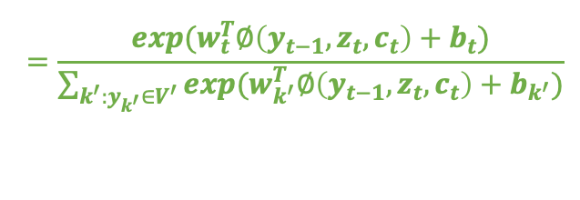
Seq2Seq
Large Vocabulary
Limitations
2. Large Vocabulary
Batch local short-lists
Partition the training corpus and define a subset $V^{′}$of the target vocabulary for each partition prior to training
$$V_{1}^{′}$$ | $$V_{2}^{′}$$ | $$V_{3}^{′}$$ | $$V_{4}^{′}$$ | … | $$V_{n}^{′}$$
$$Q_{i}\left(y_{k}\right)=\left\{\begin{aligned}\frac{1}{\left|V_{i}^{′}\right|} if y_{k}∈V_{i}^{′} \\ 0 otherwise\end{aligned}\right.$$
Let $V_{i}^{′}$ refers to the subset of target words used for $i^{th}$ partition and
From equation
$$E_{P}\left[∇ε(y)\right]≈\sum_{k:y_{k}∈V^{′}}{\frac{w_{k}}{\sum_{k^{′}:y_{k^{′}}∈V^{′}}{w_{k^{′}}}}∇ε\left(y_{k}\right)} where w_{k}=exp⁡(ε\left(y_{k}\right)−\log{Q(y_{k})})$$
$$p\left(y_{t} | y_{<t},x\right)≈\frac{w_{k}}{\sum_{k^{′}:y_{k^{′}}∈V^{′}}{w_{k^{′}}}}=\frac{exp⁡(ε\left(y_{t}\right)−\log{Q(y_{t})})}{\sum_{k^{′}:y_{k^{′}}∈V^{′}}{exp⁡(ε\left(y_{k^{′}}\right)−\log{Q(y_{k^{′}})})}}$$
$$=\frac{exp⁡(ε\left(y_{t}\right)+log⁡(\left|V^{′}\right|))}{\sum_{k^{′}:y_{k^{′}}∈V^{′}}{exp⁡(ε\left(y_{k^{′}}\right)+log⁡(\left|V^{′}\right|))}}$$
$$=\frac{exp⁡(ε\left(y_{t}\right)exp(log⁡(\left|V^{′}\right|))}{\sum_{k^{′}:y_{k^{′}}∈V^{′}}{exp⁡(ε\left(y_{k^{′}}\right)exp(log⁡(\left|V^{′}\right|))}}$$
$$=\frac{exp⁡(w_{t}^{T}∅\left(y_{t−1},z_{t},c_{t}\right)+b_{t})}{\sum_{k^{′}:y_{k^{′}}∈V^{′}}{exp⁡(w_{k^{′}}^{T}∅\left(y_{t−1},z_{t},c_{t}\right)+b_{k^{′}})}}$$
On Using Very Large Target Vocabulary for Neural Machine Translation, Jean at al., ACL 2015

Slide 16
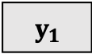

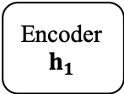
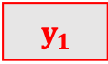
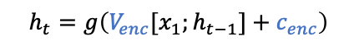
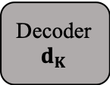

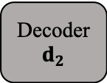




Seq2Seq
Large Vocabulary
Limitations
2. Large Vocabulary
Batch local short-lists
Substituting partition
1. Paper (fix vocab size, variant in batch size)
: collect subset documents until the number of unique words reach to a threshold $τ$
2. Fix batch size, variant in vocab size
: each subset has equivalent batch size
3. Random sampling
: randomly sample vocabulary for every iteration, but the target words should be contained
$${ y}_{1}$$
$${ y}_{2}$$
…
<EOS>
$$h_{t}=g\left(V_{enc}[x_{1};h_{t−1}]+c_{enc}\right)$$
$$d_{t}=g\left(V_{dec}[y_{d};d_{t−1}]+c_{dec}\right)$$
Encoder
$$h_{1}$$
…
Encoder
$$h_{T}$$
Decoder
$$d_{1}$$
Decoder
$$d_{2}$$
…
Decoder
$$d_{K}$$
$$h_{T}$$
$${ x}_{1}$$
…
$${ x}_{T}$$
<EOS>
$${ y}_{1}$$
…
$${ y}_{K}$$
On Using Very Large Target Vocabulary for Neural Machine Translation, Jean at al., ACL 2015

Slide 17







Seq2Seq
Large Vocabulary
Limitations
3. Limitations
1) Hard to capture long term dependency
…
Encoder
$$h_{1}$$
Encoder
$$h_{2}$$
…
Encoder
$$h_{T}$$
$$h_{T}$$
$${ x}_{1}$$
$${ x}_{2}$$
…
$${ x}_{T}$$
Information of long term is faded
LSTM, Bi-directional RNN somewhat alleviates the problem but can’t solve completely
Solutions:
Attention mechanism

Slide 18

























Seq2Seq
Large Vocabulary
Limitations
3. Limitations
2) Parallel computing
$$\frac{∂L}{∂h_{2}}=\frac{∂L_{2}}{∂{\hat{y}}_{2}}\frac{∂{\hat{y}}_{2}}{∂h_{2}}+\frac{∂L_{3}}{∂{\hat{y}}_{3}}\frac{∂{\hat{y}}_{3}}{∂h_{3}}\frac{∂h_{3}}{∂h_{2}}+…+\frac{∂L_{T}}{∂{\hat{y}}_{T}}…\frac{∂h_{3}}{∂h_{2}}$$
$$L$$
$$L_{1}$$
$$L_{2}$$
$$L_{3}$$
$$L_{T}$$
$${\hat{y}}_{1}$$
$${\hat{y}}_{2}$$
$${\hat{y}}_{3}$$
$${\hat{y}}_{T}$$
$$W$$
$$W$$
$$W$$
$$W$$
$$h_{0}$$
$$f_{w}$$
$$h_{1}$$
$$f_{w}$$
$$h_{2}$$
$$f_{w}$$
$$h_{3}$$
$$…$$
$$h_{T}$$
$$x_{1}$$
$$x_{2}$$
$$x_{3}$$
Derivative of time n is dependent to derivatives of after time n
Impossible to enable parallel computing
Solutions:
Transformer

Slide 19
Seq2Seq
Large Vocabulary
Limitations
3. Limitations
3) Exposure bias problem
Trained to predict next word in summary (MLE)
Training time $≠$ Testing time
Training time: words drawn from data distribution
Testing time: words drawn from model distribution

Slide 20


